Slide 1
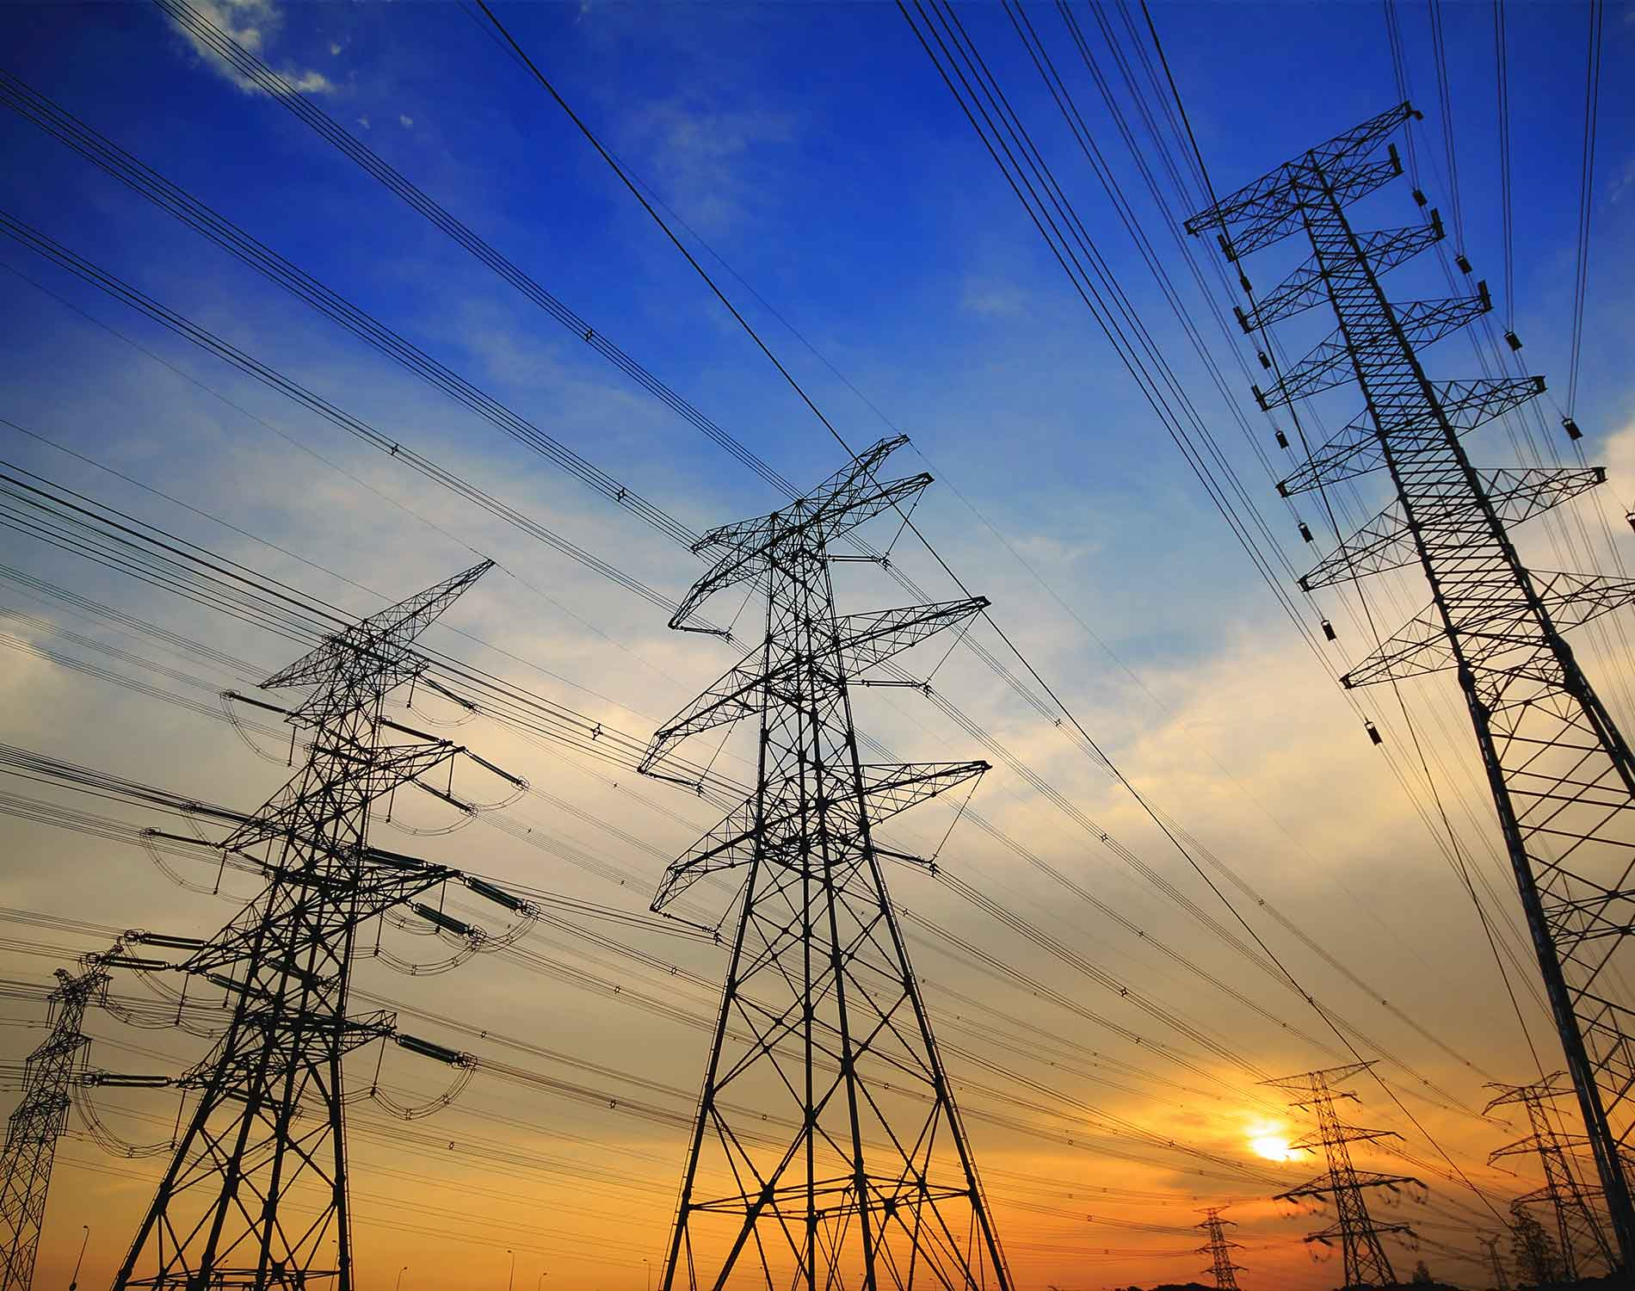

Predicting Long-Term Energy Prices
Andrew | Rohan | Jordan

Slide 2
The Problem

Slide 3
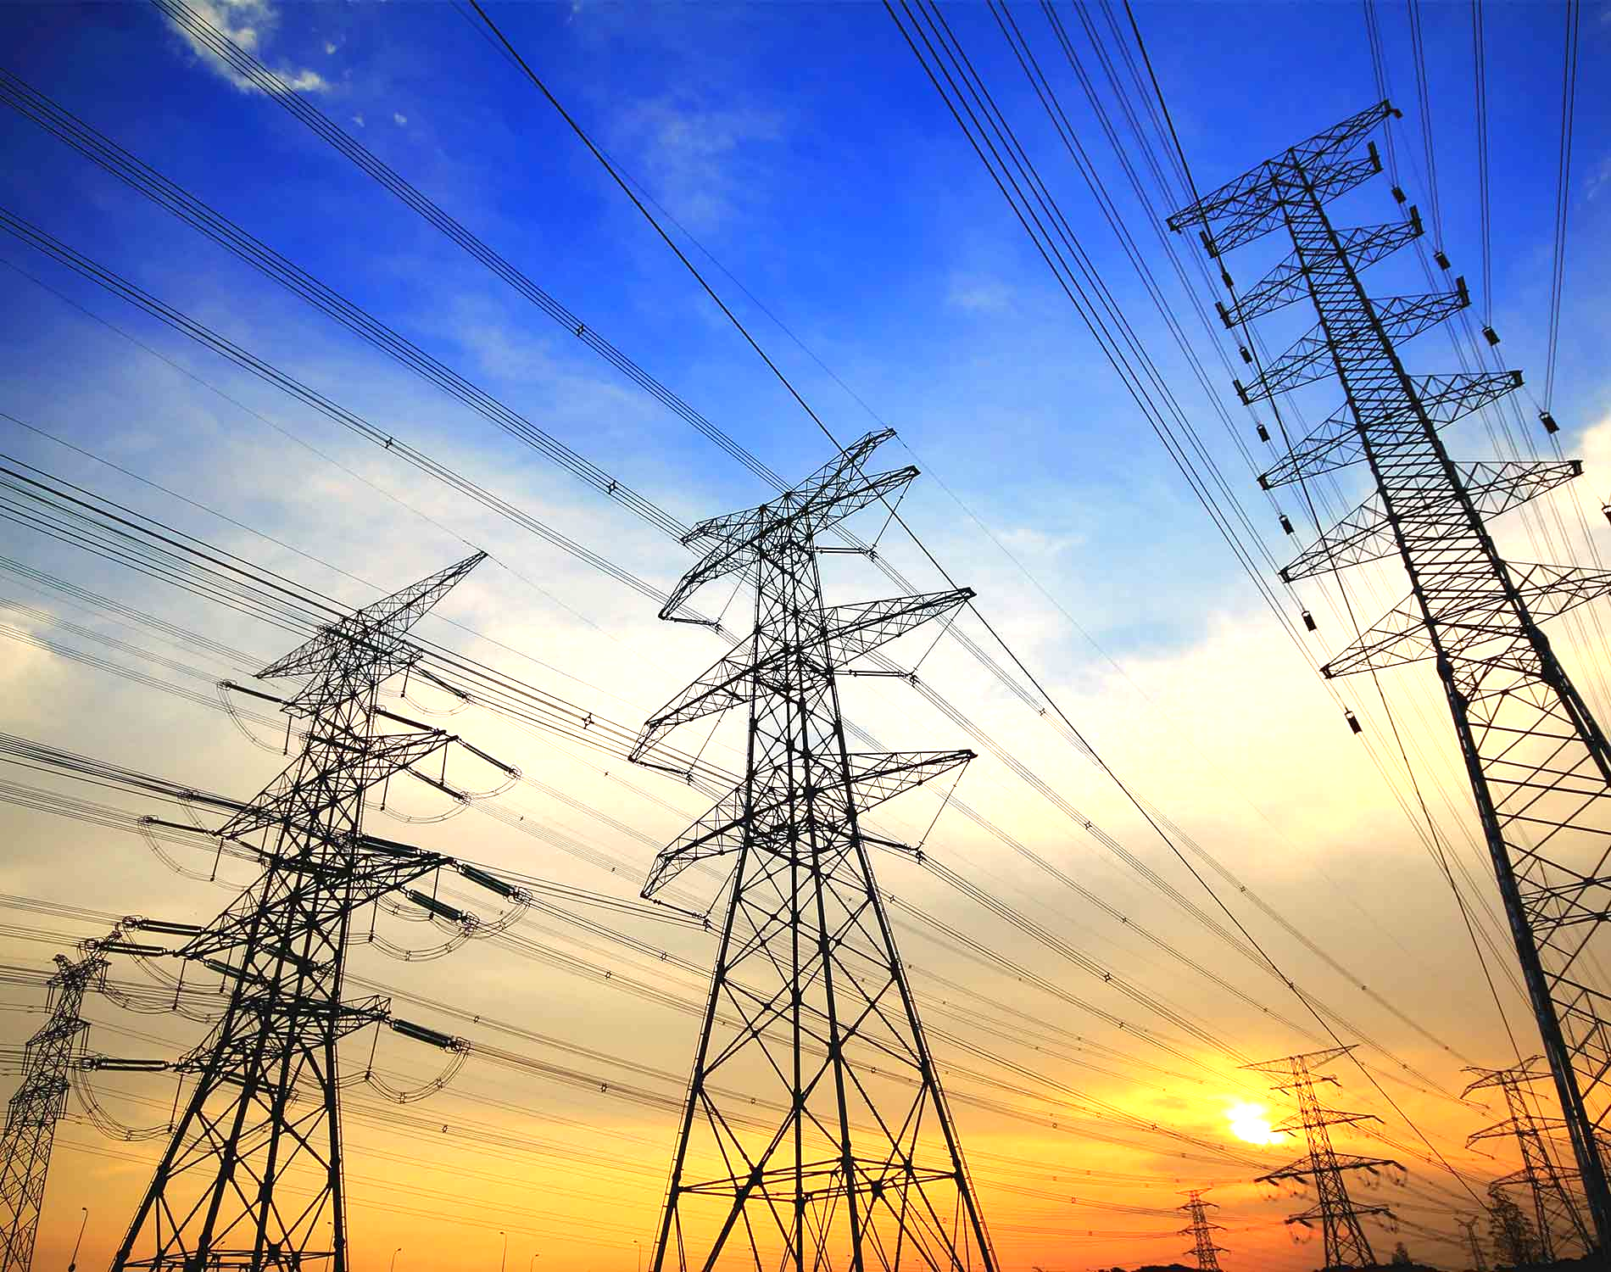
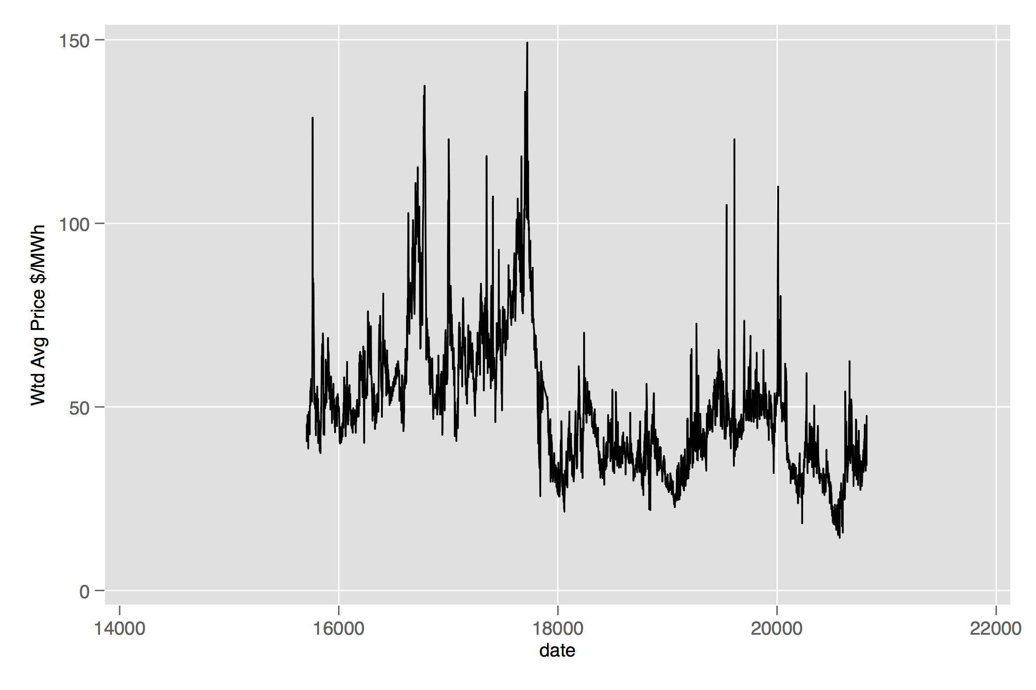
Energy prices are noisy (2003–2015)

Slide 4
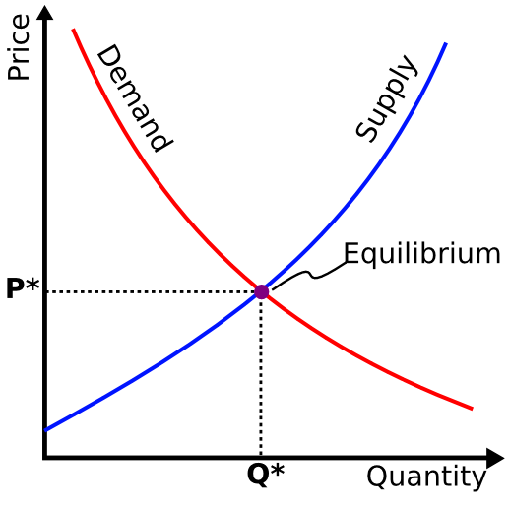
Energy markets

Slide 5
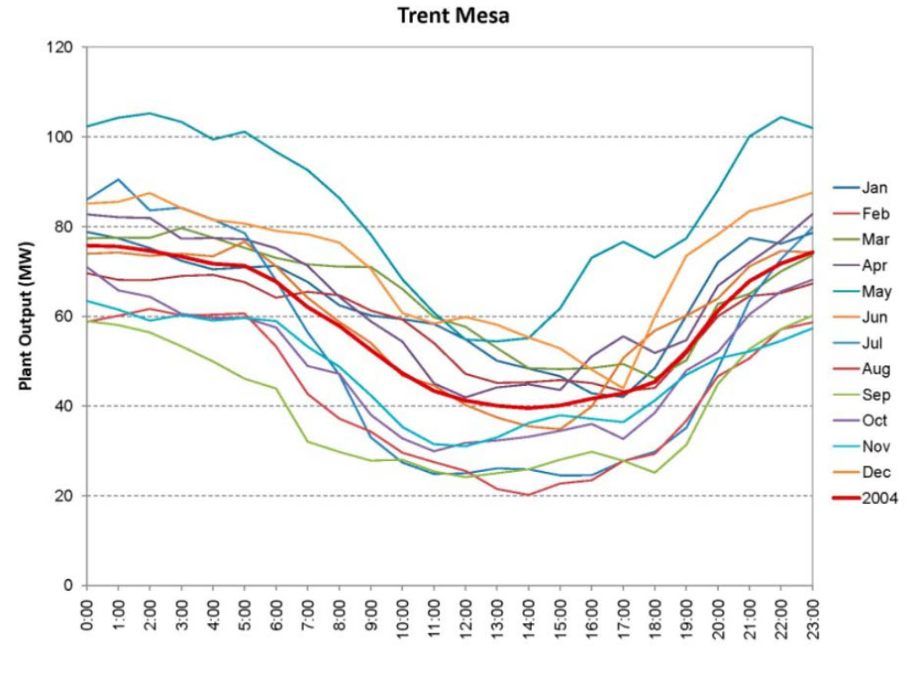
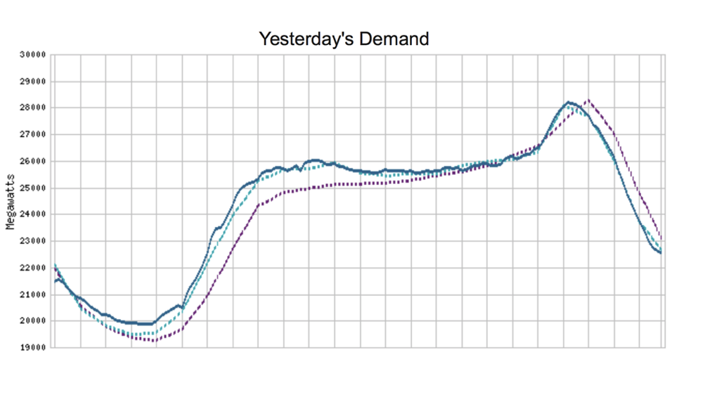
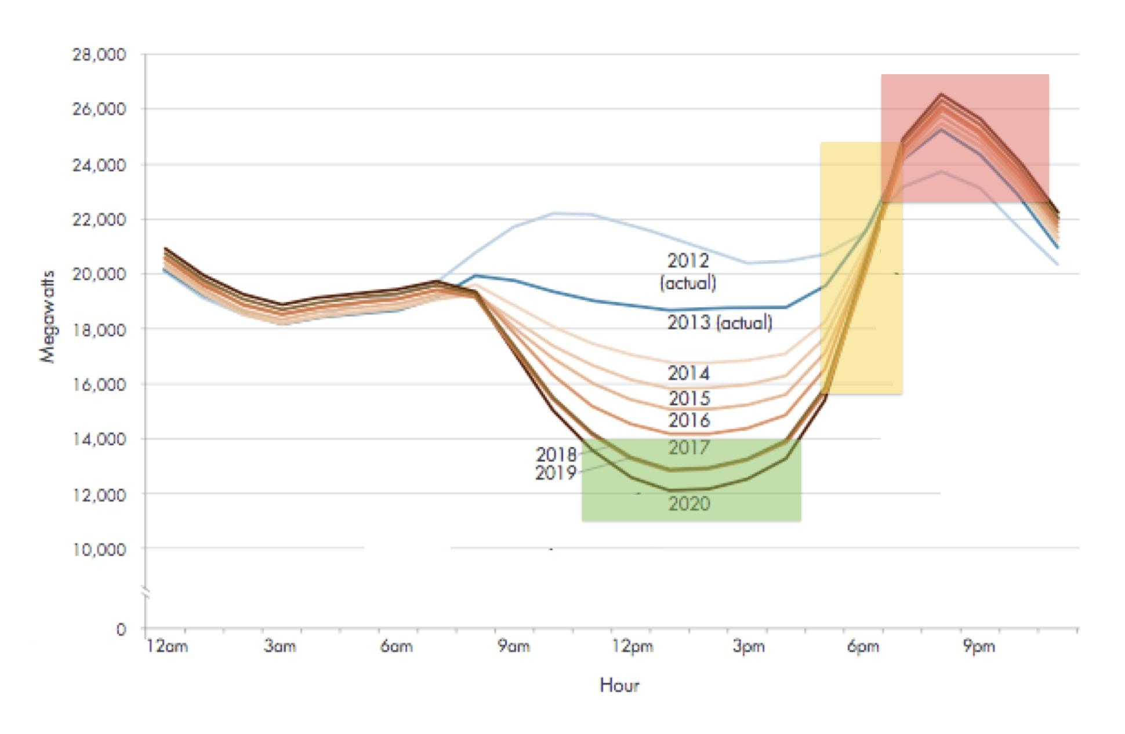
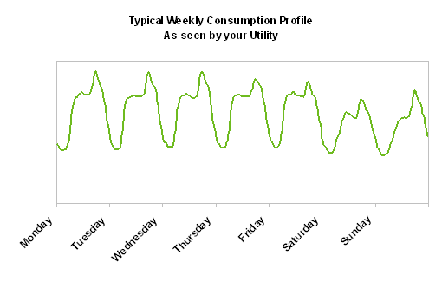
Demand
MONTHLY
DAILY
YEARLY
WEEKLY

Slide 6
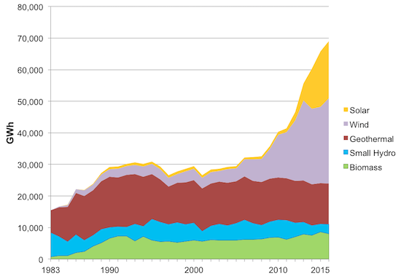
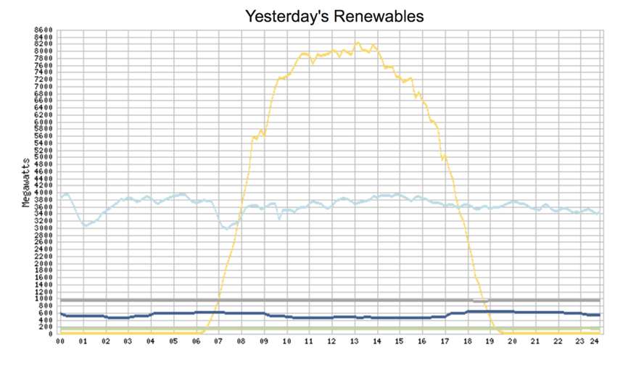
Supply
long run
short run

Slide 7
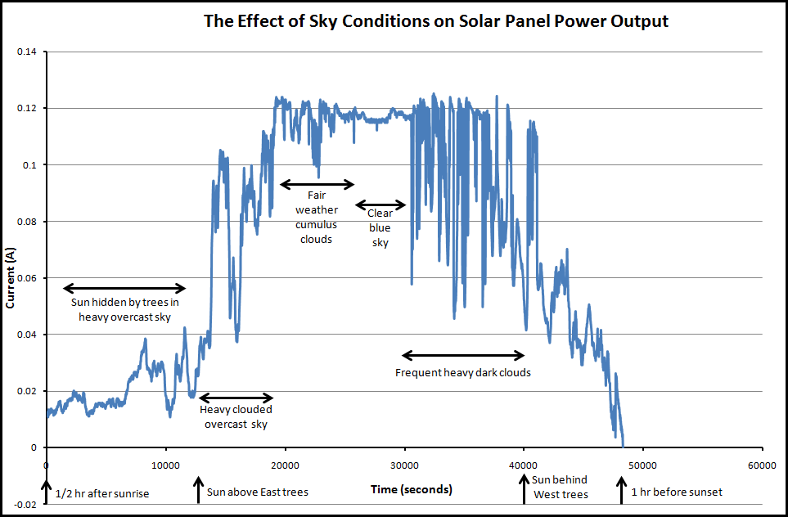
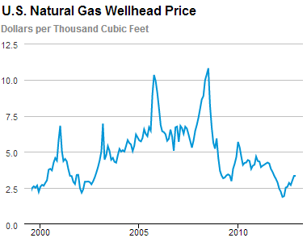
Other important factors: weather and gas prices

Slide 8
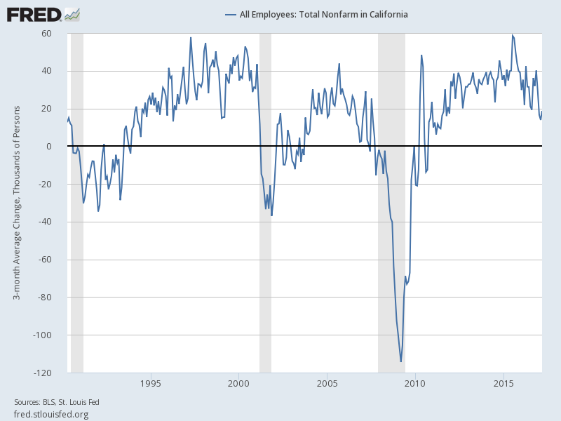
Other important factors: macroeconomy

Slide 9
Building the Dataset

Slide 10
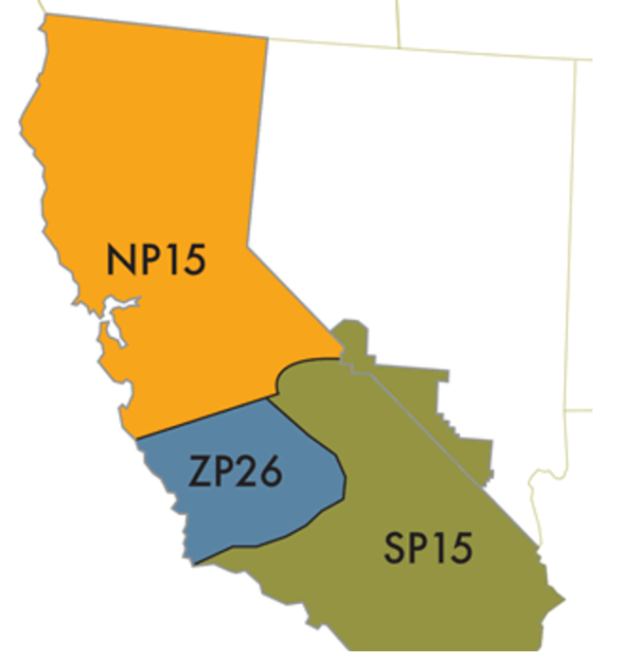
We took energy prices from CAISO SP-15
SP-15 consists of the broader southern california region
To populate our data with demographic and employment information from the census, we broke down SP-15’s region into roughly 11 counties in SoCal:
Mono
Inyo
Tulare
Kern
Ventura
Orange
San Bernadino
Riverside
San diego
LA
Imperia

Slide 11

Other predictor data includes...
Daily natural gas prices
Number of trades and bidders
Weather patterns and cloud coverage

Slide 12
Models

Slide 13
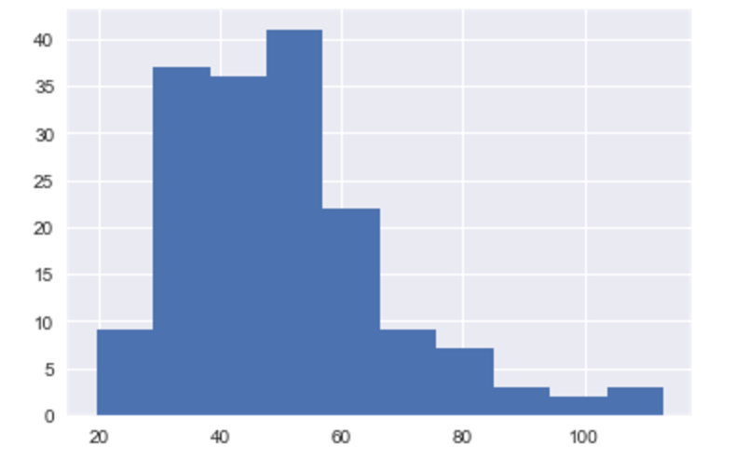
Baseline “state of the art” for debt valuation
Distribution of monthly price averages since 2002
95% confidence interval is [25.8, 95.1]
80% confidence interval is [31.8, 71.5]

Slide 14
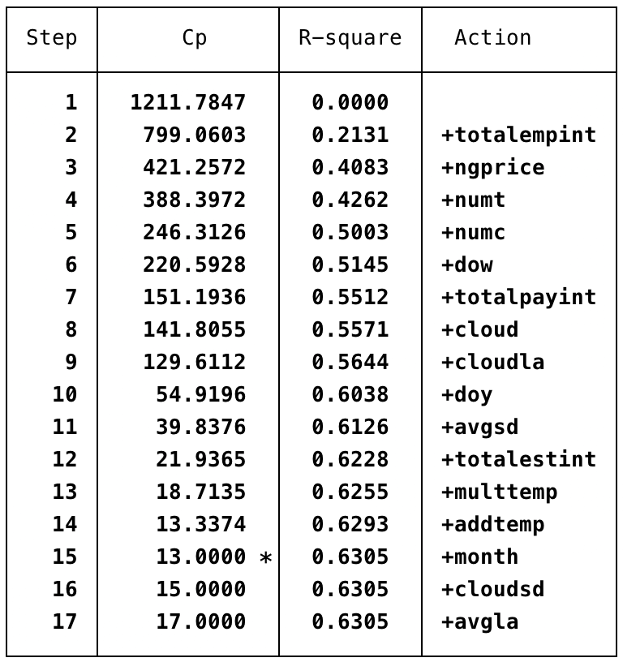
LASSO for optimal model selection (same-day)

Slide 15
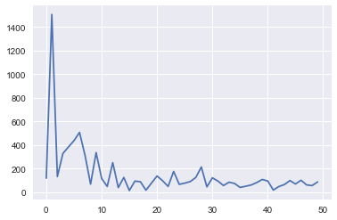
Fourier transformation (no dominant seasonality)
month

Slide 16
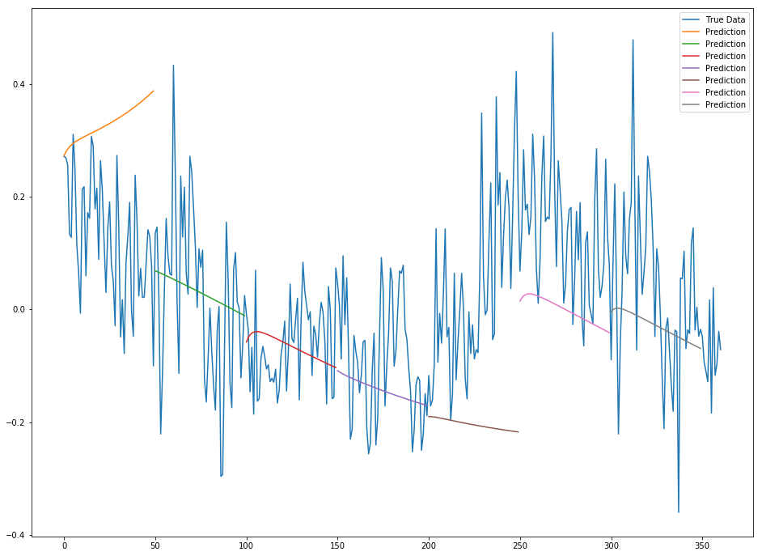
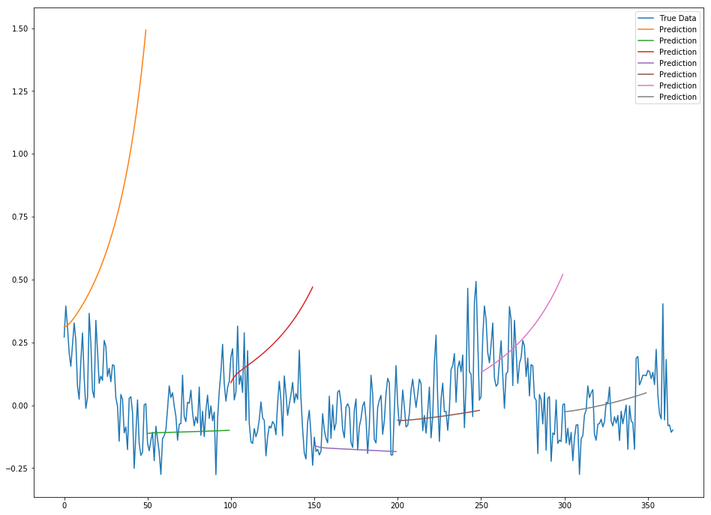
How well does an LSTM RNN do on price alone?
Sequence length of 100
Sequence length of 50
Notes:
Neural Networks these days are the “go to” thing
Training sequence length (read window size) of 50 and 100, as well as 25 and 200, but the latter two didn’t show much insight. The goal is to allow for the network so get glimpses of the shape of the energy signal at each sequence and hence will hopefully teach itself to build up a pattern of the sequences based on the prior window received, but the result showed that because energy prices fluctuate so much that this model is not an effective way to predict energy prices

Slide 17
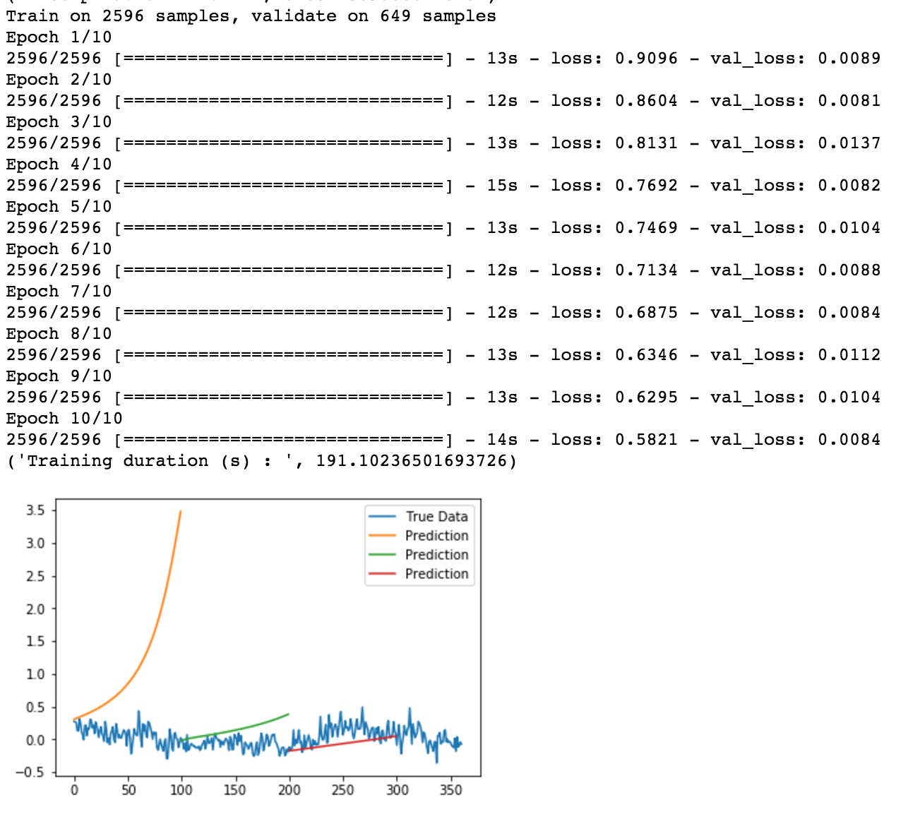
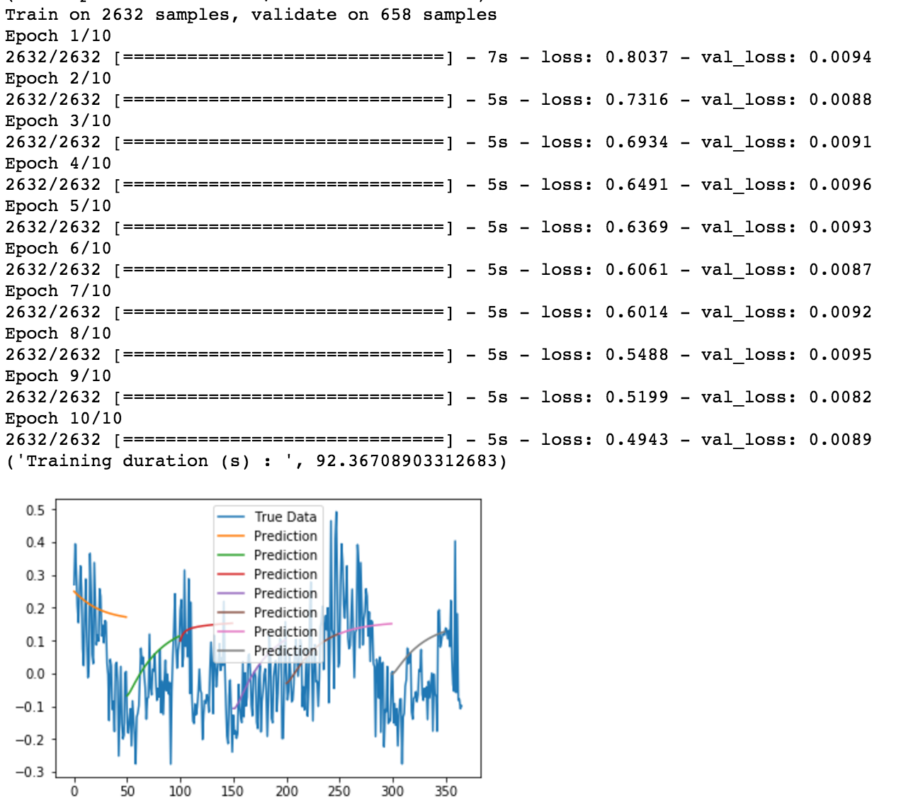
How well does an LSTM RNN do on price alone?
Sequence length of 100
Sequence length of 50

Slide 18
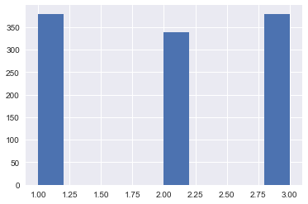
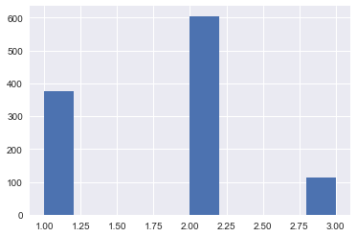
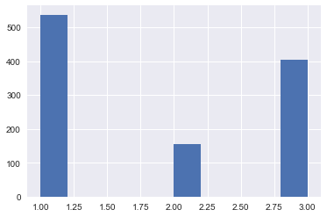
Random Forest Classifier
Distribution of test data across
3 buckets is fairly even
Distribution of test output across
3 buckets is skewed to bucket 2
Distribution of predicted outcome across
3 buckets is NOT skewed to bucket 2

Slide 19
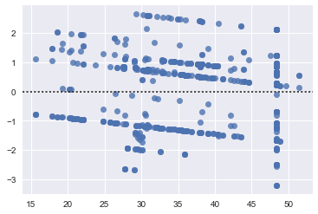
Random Forest Regressor
Residual Plot from predicting 730 monthly average prices 2 years after training data ends
Mean of residuals is 8.4 but changes each time model is run

Slide 20
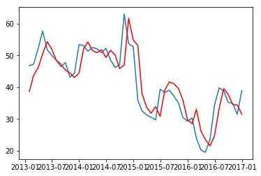
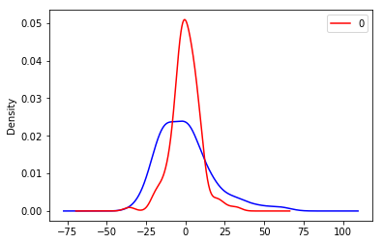
ARIMA forecast is fairly accurate and improves on random guessing (R² = 0.79)

Slide 21
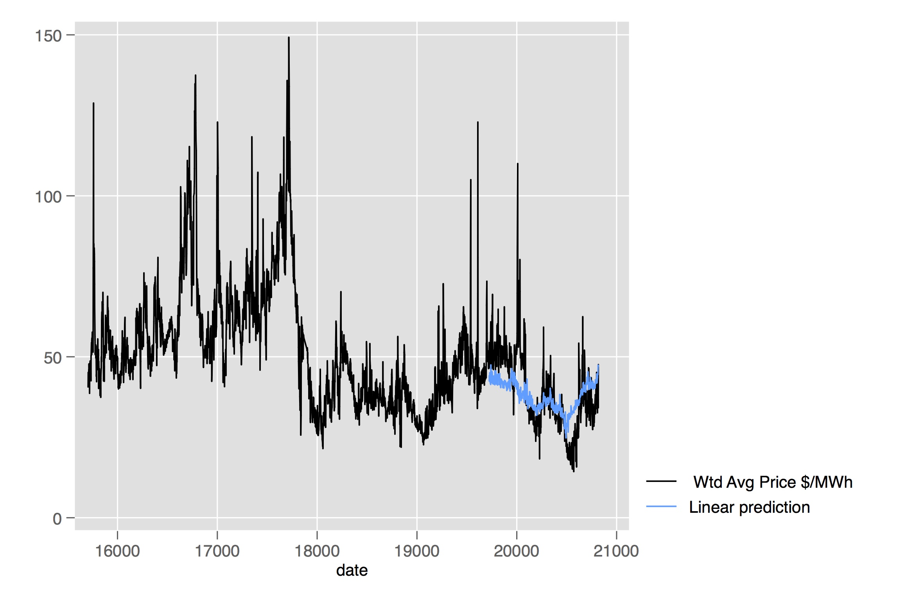
Simple lagged linear regression models:
cannot capture breaks in trend/outliers, but R² = 0.72
Notes:
Train regression on two-year ahead data and put current data into the trained model to predict energy prices; a lot of this is just a sign of the long-run stability of energy price data

Slide 22
What we’ve learned
Finding high quality, localized data is difficult
It is important to understand which features are most predictive
Long term prediction within some confidence interval appears doable
Models that didn’t work:
LSTM (RNN) on prices alone
LTI/Fourier analysis to estimate seasonality
Random forest classifier
Somewhat accurate
Multivariate ARIMAX (though this is already used by more advanced industry players)

Slide 23
What could work
Models that could work:
Linear regression
Random Forest Regressor
Linear Dynamic System
Gaussian state space models
Vector autoregressive models with forecasts from ARIMA on individual time series
Make your own input data for the future
Find highly predictive features of energy prices 3+ years out
Build individual regressions for each feature projected out 3+years
Use model trained on current and past data and apply to newly created future data
Key takeaway: over half of variation is explained by total employment (best estimated with macroeconomic intuition) and natural gas prices (dependent on many things [including energy prices!] and itself highly variable)

Slide 24
Missing: policy
Policy changes are a key determinant of energy prices, especially in CA
Recently announced: potential 100% RPS by 2060
In addition to CA policy, also consider geopolitical trends and somewhat arbitrary choices by foreign leadership

